Slide 1





SECR1033 COMPUTER ORGANIZATION AND ARCHITECTURE
SECTION 3
GROUP PROJECT
LECTURER: DR. FOAD BIN ROHANI
Members:
Chua Jia Lin
Neo Li Xin
Brendan Chia Yan Fei

Slide 2
SECJ1023 PROGRAMMING TECHNIQUE II
SECTION 2
PROJECT PROPOSAL
LECTURER: DR. JOHANNA BINTI AHMAD
Members:
Chua Jia Lin
Neo Li Xin
Brendan Chia Yan Fei

Slide 3
PROJECT
SYNOPSIS
For this project, we plan to design a pharmacy system called Caring Pharmacy System.
Purpose of designing this system:
enable admin to check the transaction history in more systematic and organised way
speed up the transaction process as customer can undergoes the transaction process by themselves using the system.

Slide 4
GENERAL IDEA
OF PROJECT
We prepared two roles which are customer and admin.
Admin:
View customer list, amount paid by customers, and customers’ payment method
View number of medicine sold, and total number of medicine sold
View sales of medicine, and total sales of medicine
Customer:
Enter name
Choose type of medicine
Enter amount of medicine
Choose payment method

Slide 5
CUSTOMER PANEL
The system will confirm with the customer on whether they need another medicine
If “n” is chosen, the system will prompt the customer to select a payment method as displayed
The system will display the list of the 3 most common medicine
2
4
6
1
3
5
Prompt the customer to enter their name
Customers are required to choose a medicine based on the respective numbering
If the customer choose “y”, they need to choose another medicine.

Slide 6
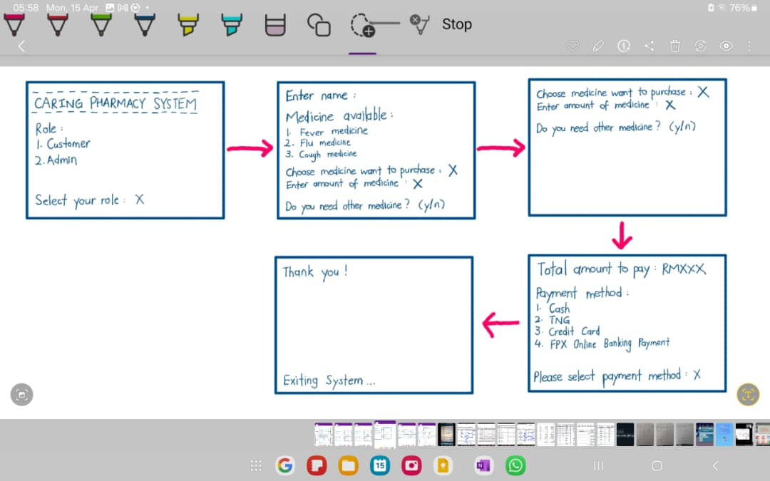
STORYBOARD
ROLE : CUSTOMER

Slide 7
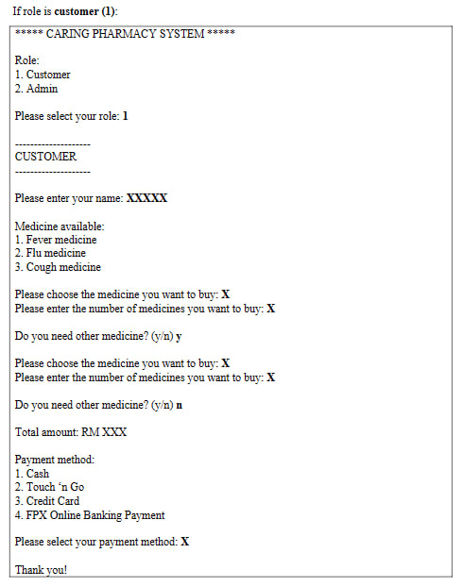
EXPECTED FINAL
OUTPUT
ROLE : CUSTOMER

Slide 8
ADMIN PANEL
Operation 1: View the customer list, amount paid by customers and their payment method
Operation 2: View the number of medicine sold for each category and total number of medicine sold
Operation 3: View the sales for each type of medicine and the total sales

Slide 9
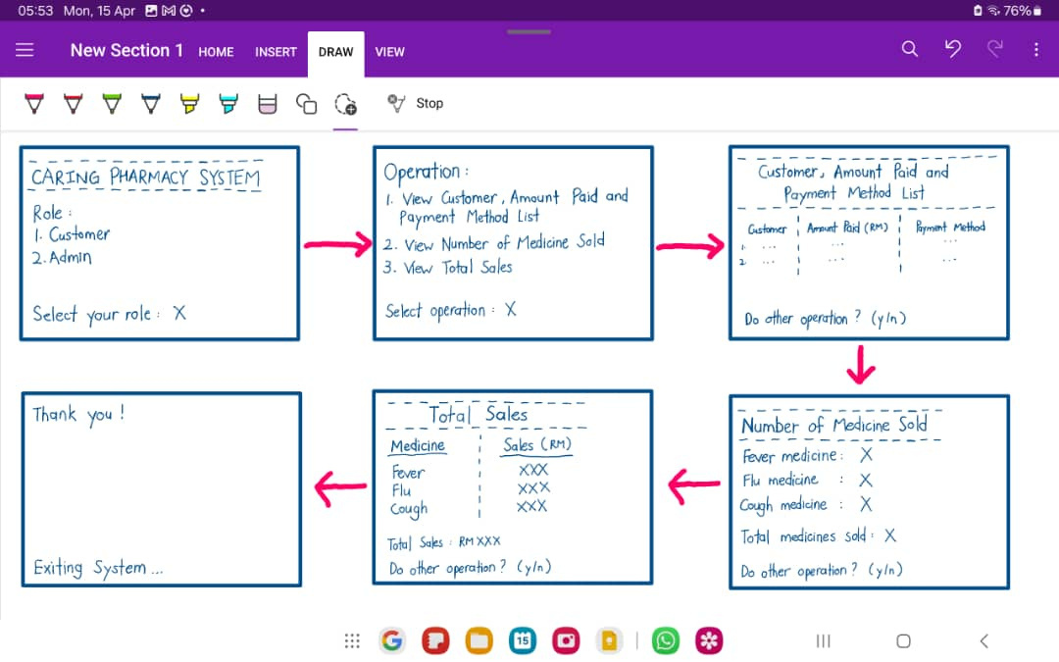
STORYBOARD
ROLE : ADMIN

Slide 10
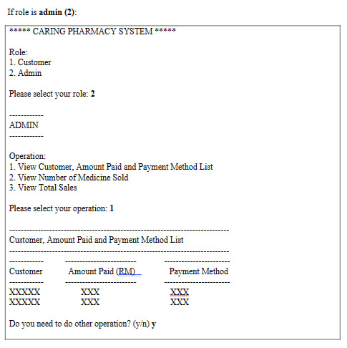
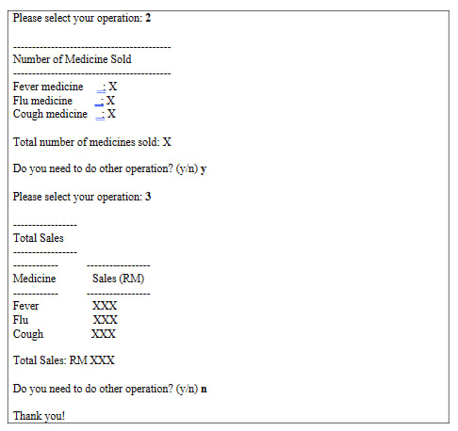
EXPECTED
FINAL
OUTPUT
ROLE : ADMIN

Slide 11
THANK YOU

